Slide 1





Navigating the Future of Health Promotion: Challenges and Opportunities – An intensive week.

Slide 2
What's it about?
Global health
Health promotion
Disease prevention
Focus on the salutogenic theory
How we can make a difference

Slide 3
Who will be there?
Students and teachers from:
Lithuania
Finland
Denmark
Sweden
Norway
A multi-discliplinary group
Social work
Nursing
Midwifery
Other

Slide 4
The course
Pre-assignment
To be done at home beforehand and discussed within groups on the first day
Intensive week Monday to Friday
The course is held the whole week
Teachers from the respective universities provide engaging lectures
Discussions
Lots of interesting, valuable discussions and reflections in groups
Final project
Together as a group, present it to teachers and other student on the last day of the course

Slide 5
The groups
One student from each country
Multi-disciplinary to provide several perspectives and a holistic view
Activities and role-play that lead to discussion and constructive feedback
Share experiences from respective disciplines and countries
Work together the entire week
Prepare and present final presentation together

Slide 6
What to expect
Intense week, lots of learning and engaging
Gaining knowledge and new perspectives in:
Global health issues
Health promotion & disease prevention
Salutogenic theory
Meeting lots of new people from different countries
Spending a week in another country
Having a great time!

Slide 7
Experiences from Spring 2025
Laurissa: Not only did I get to enjoy learning about different methods/programmes for health promotion and disease prevention that I can implement in my own nursing practice, but I was able to experience the beautiful city of Harstad and meet so many interesting people from different countries!
Dominica: It was a great experience! An intensive week is a rapid and optimal way to connect with new knowledge, people, and environments. It is something that I would recommend everyone to do.
Jennie: Except from being able to visit a beautiful city that I probably wouldn't think of otherwise, I was inspired by new ways of thinking about health promotion. The course deepened my understanding of salutogenic approaches and how they can strengthen well-being. It was a valuable and motivating experience.
Amanda: I got to travel and meet new people, all while learning about health promotion and ways to help others!

Slide 8
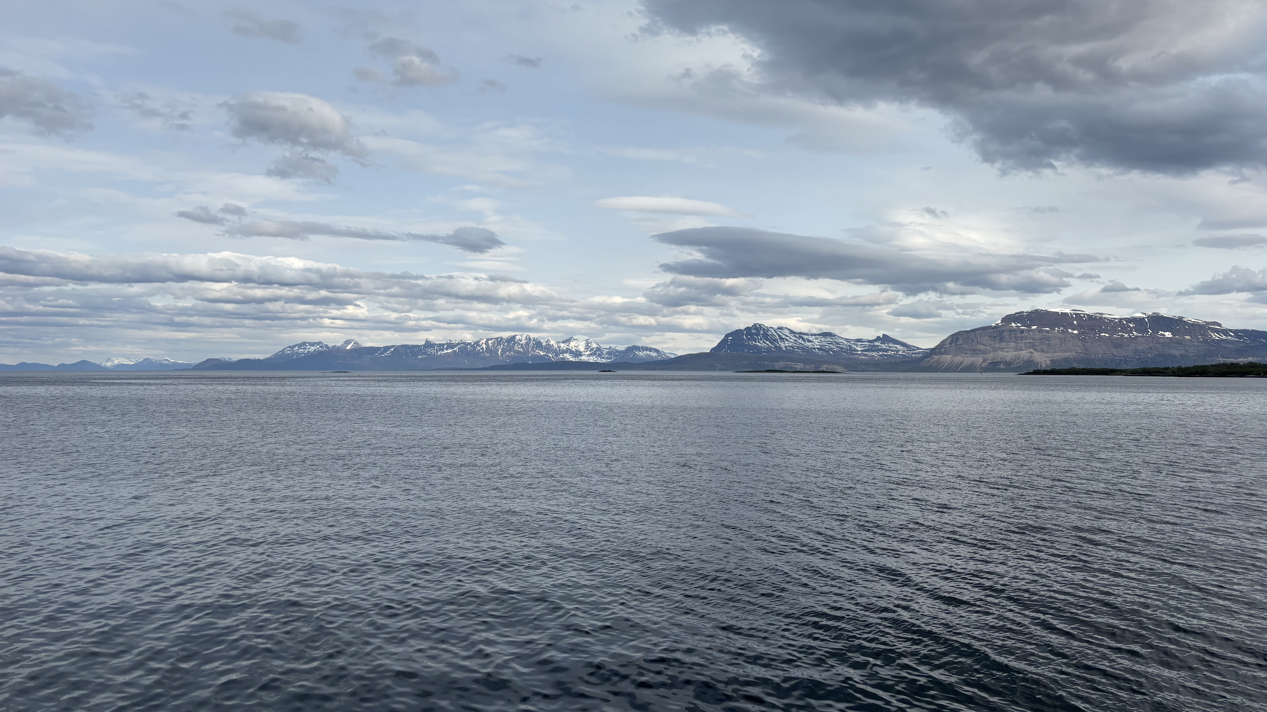

Slide 9
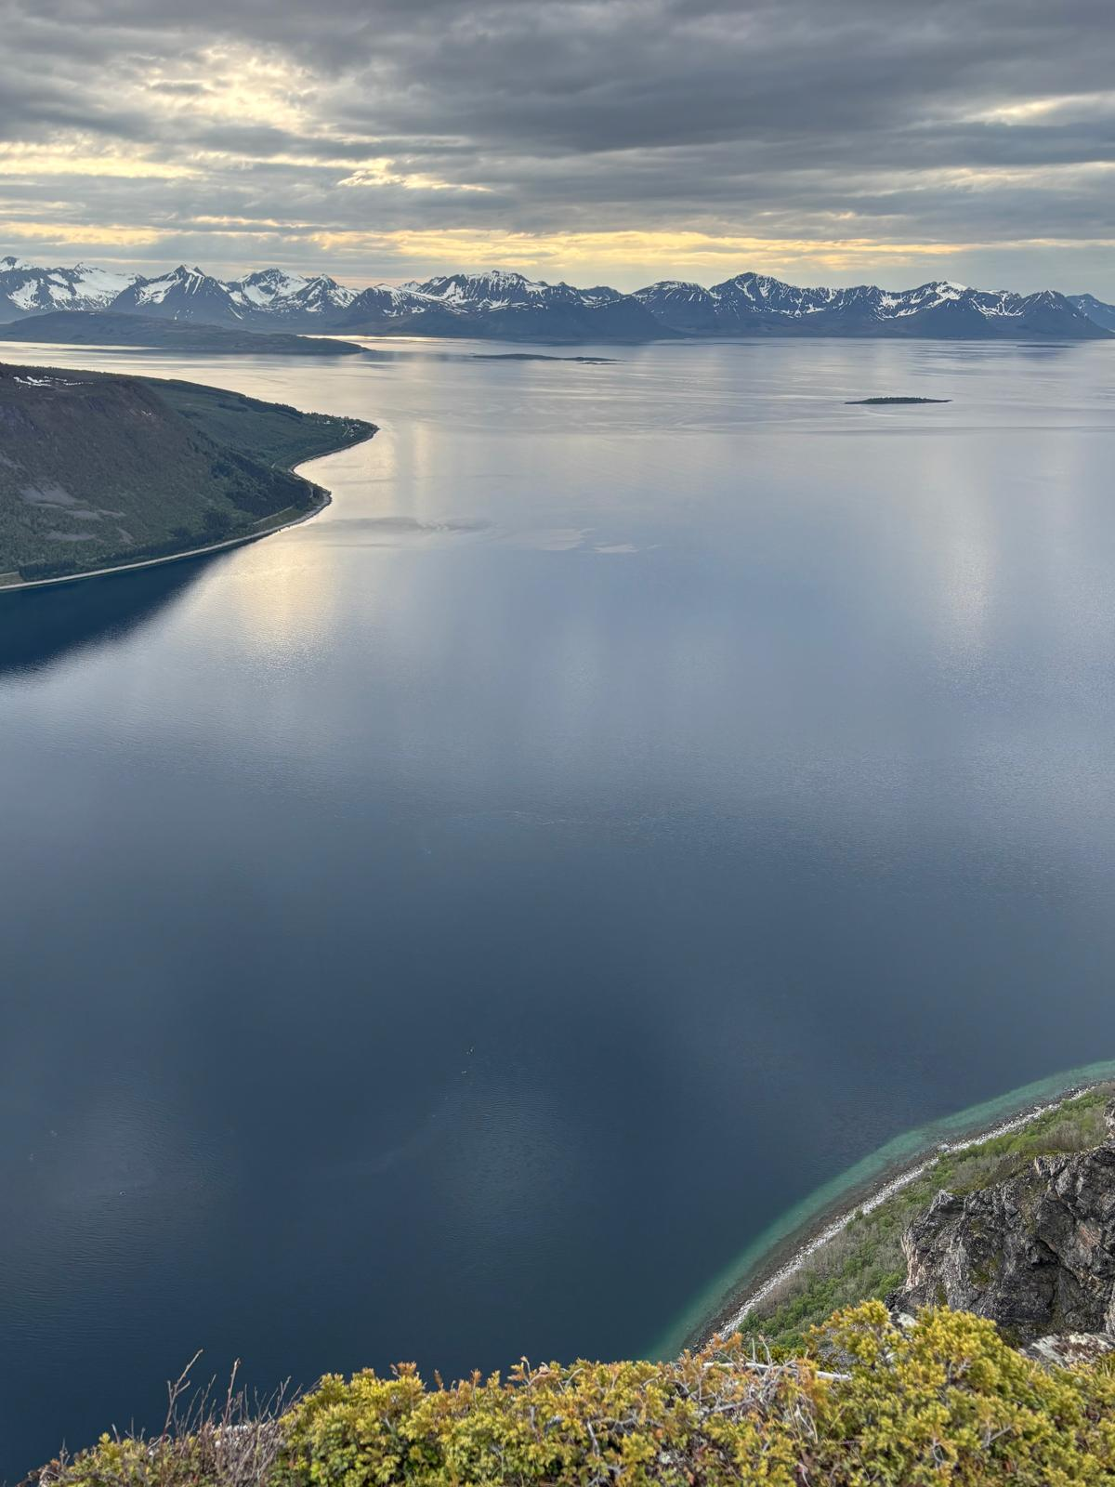
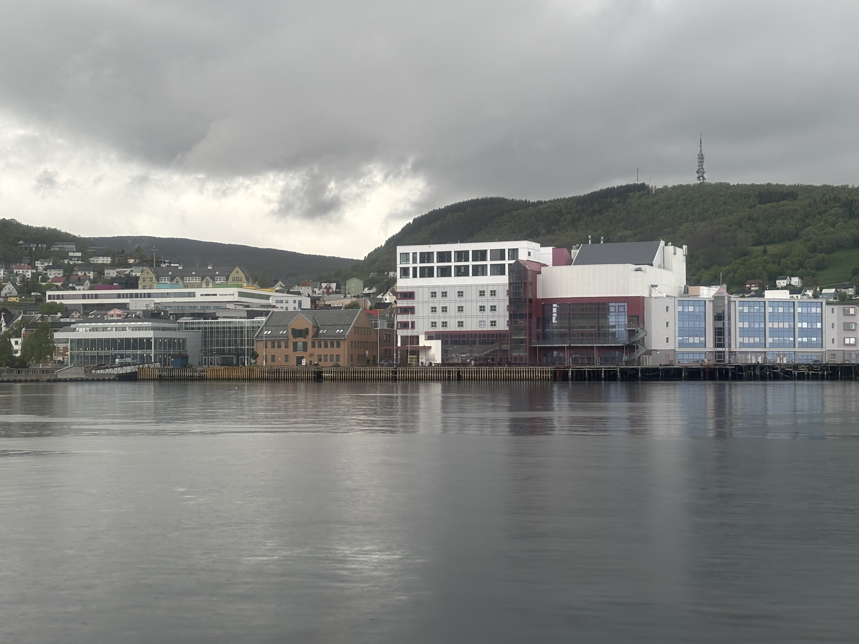

Slide 10
Pros & Cons
Pros
Cons
A week in a different country
Meeting new people
Gaining new perspectives in global health, health promotion, and disease prevention
An international exchange looks great on a resumé!
Experiencing an international exchange that is intense but only a week long, so you get all the benefits without getting homesick!
Pending... we'll let you know if we can think of any!
Dominica: No whale safari!

Slide 11
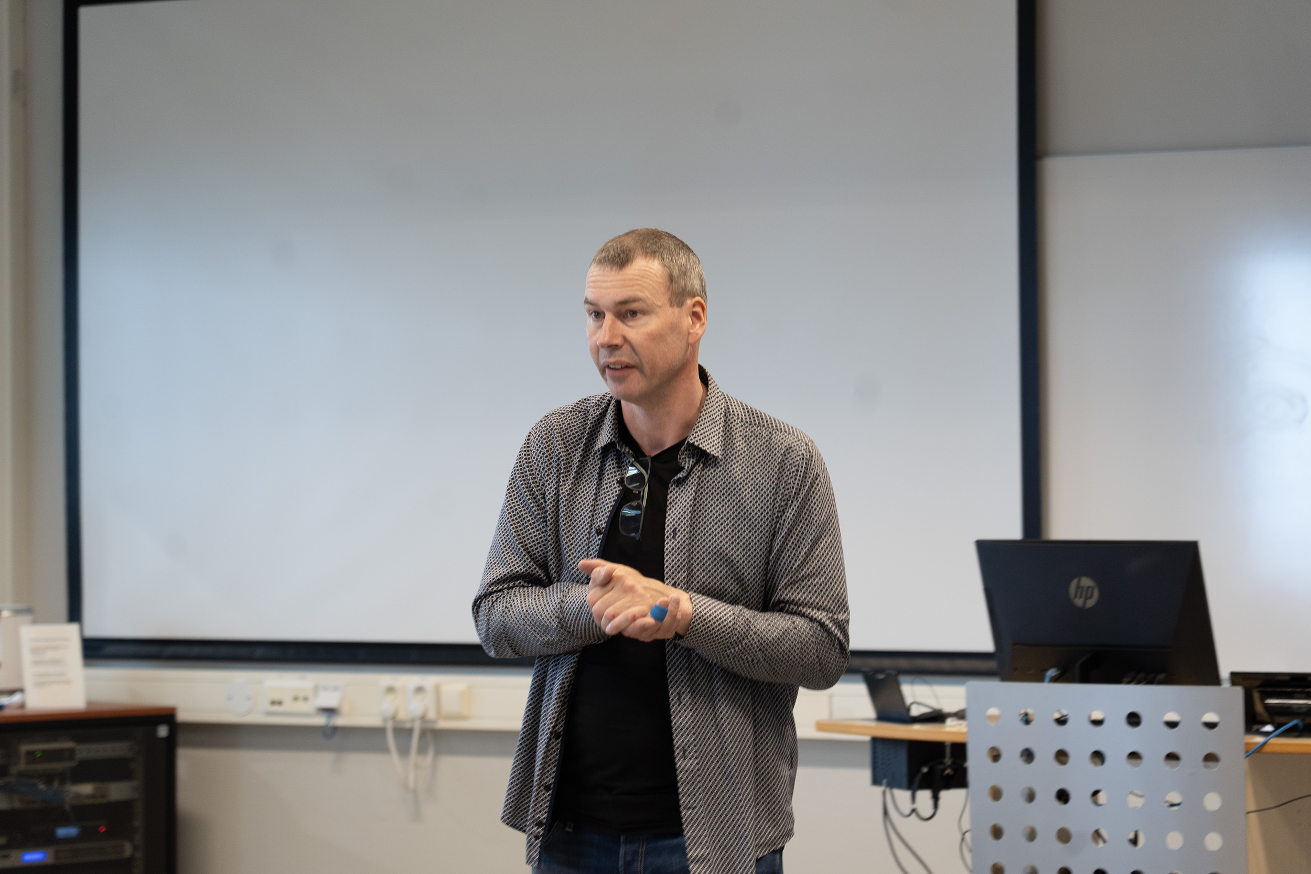
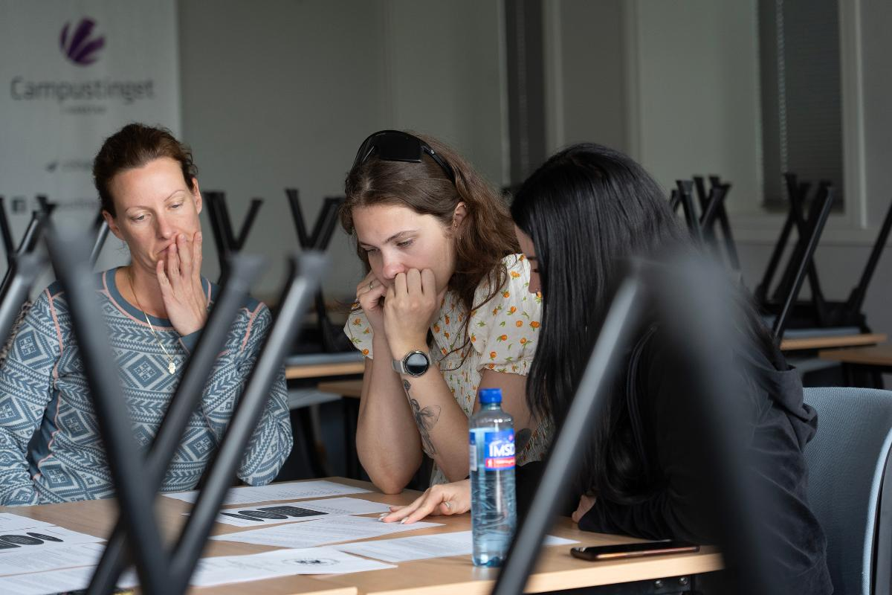
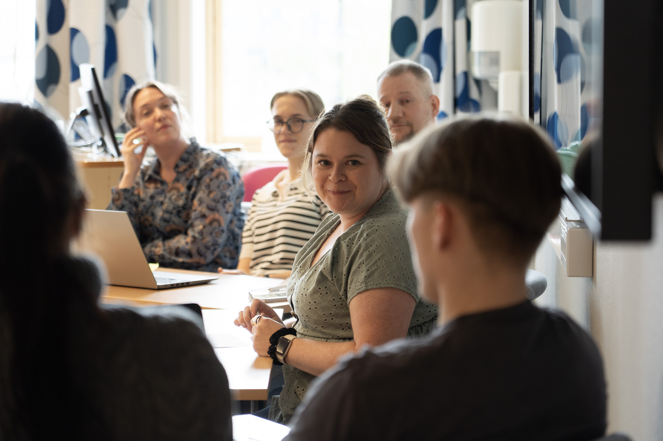
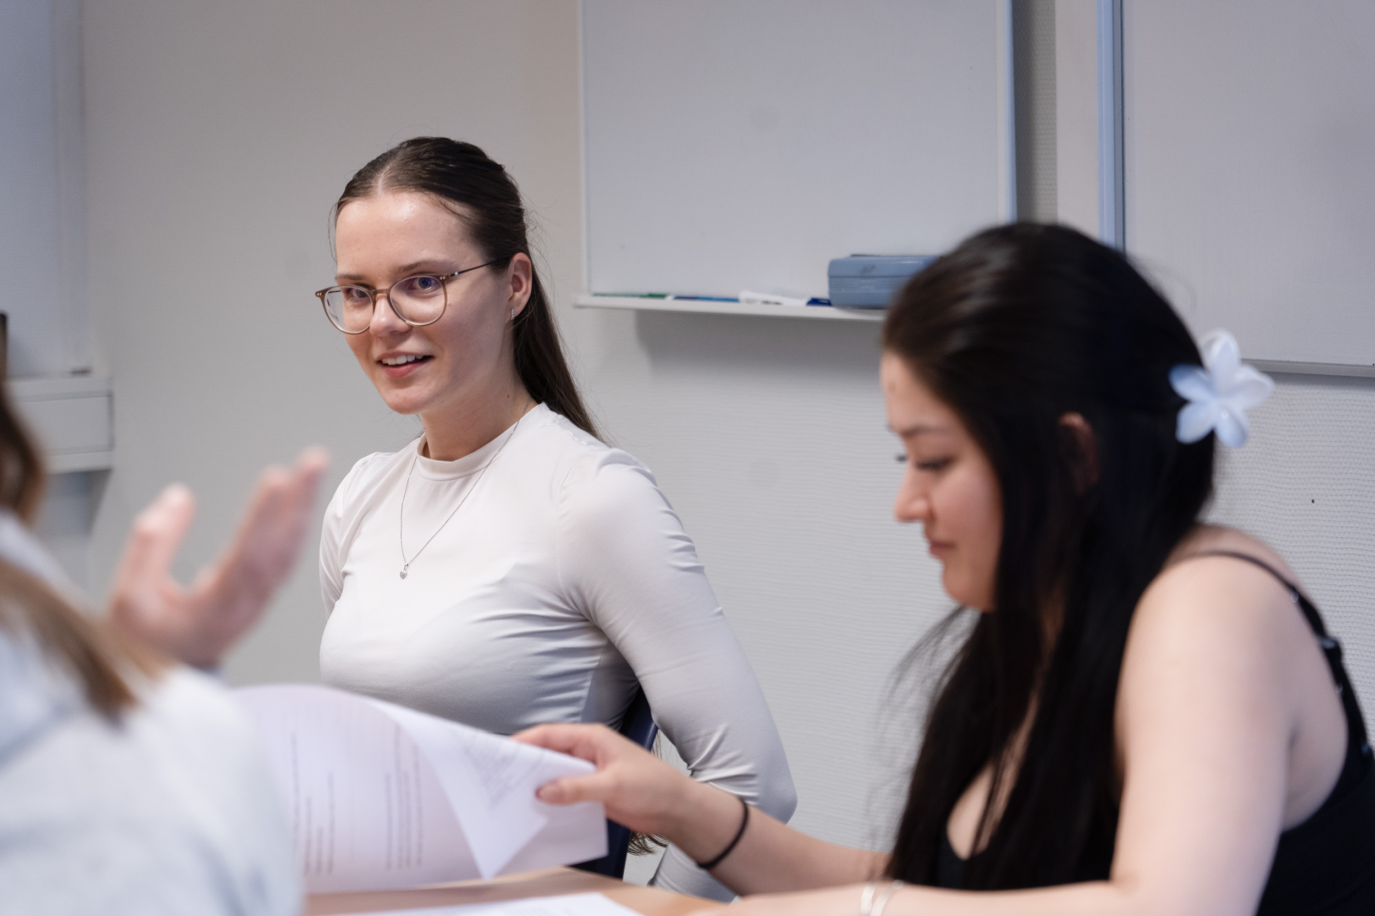

Slide 12
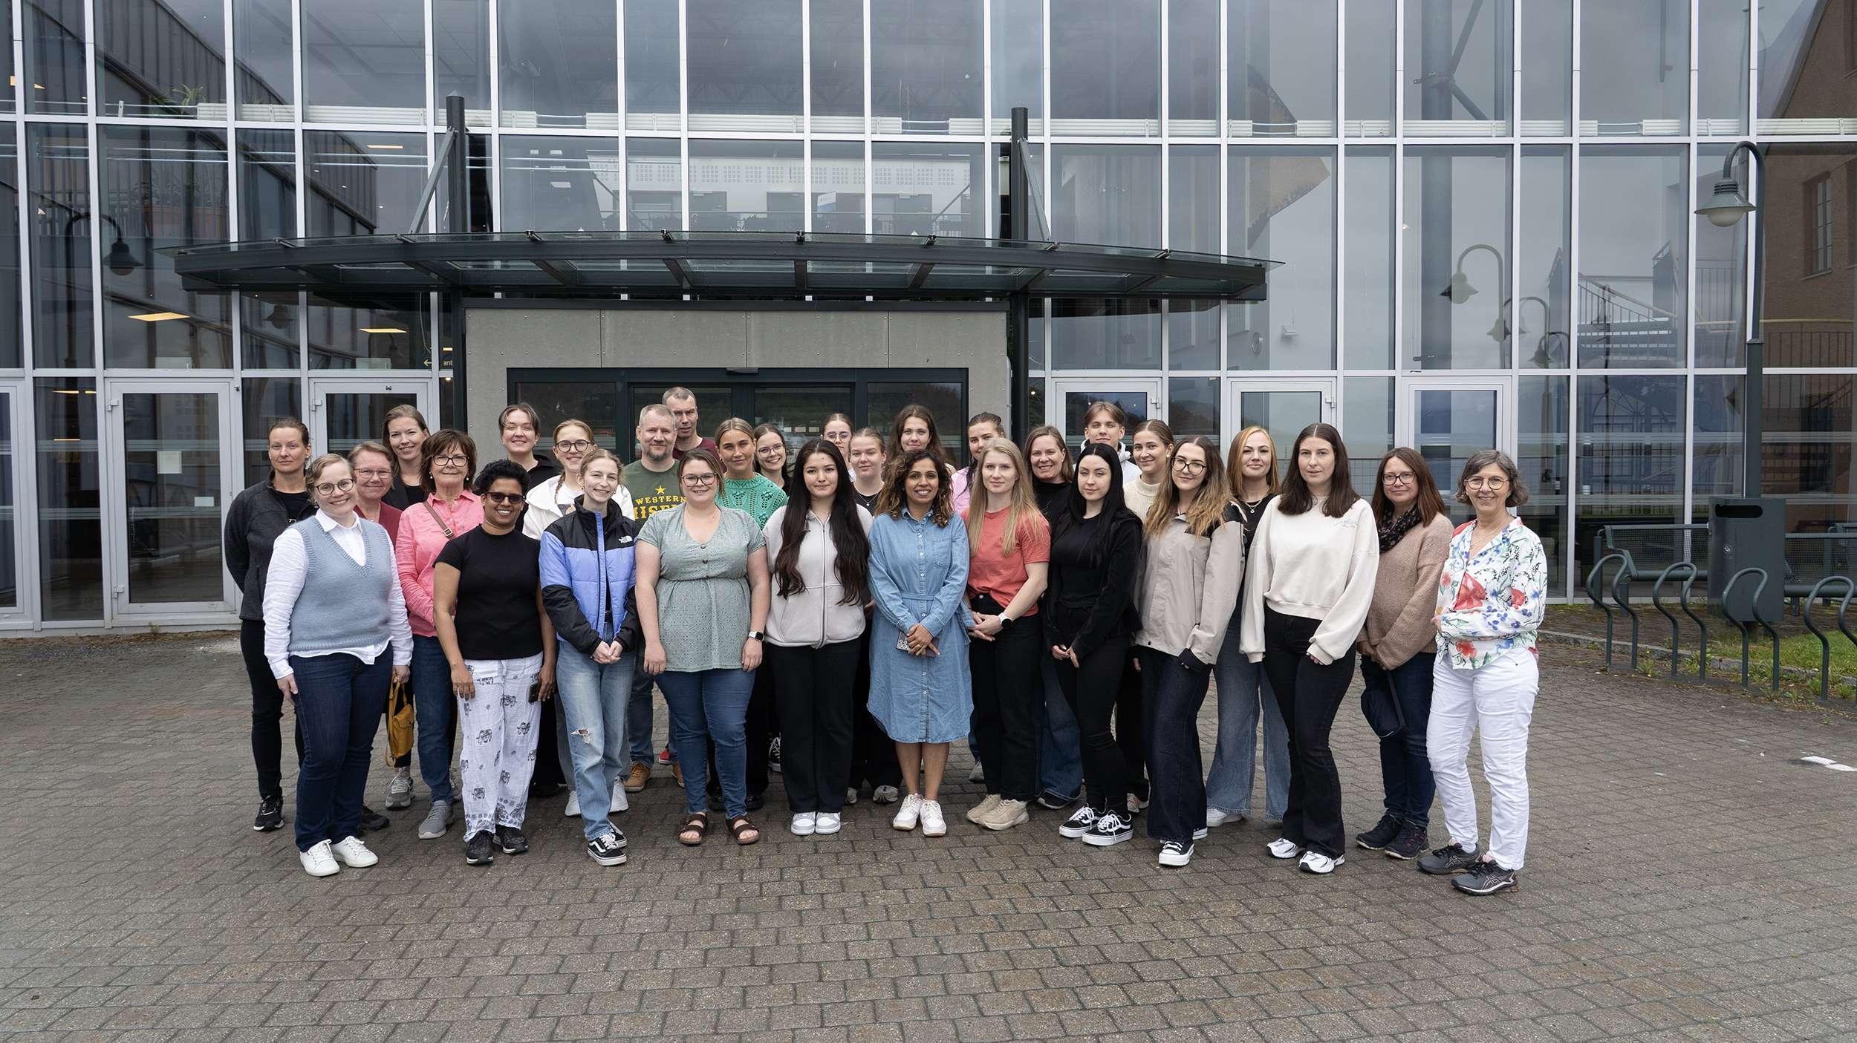

Slide 13
